Slide 1
Portfolio And Risk Analytics
Swatik Ghosh A006
Anubhav Yadav A005

Slide 2
Factors for selection
S&P BSE 500
sequential Screening
Values
P/E Ratio
P/BV Ratio
Debt to Equity
Free Cash Flow
​
Low Volatility
Beta
Standard Deviation
Quality
Altman Z-score

Slide 3
Value
Value investors use stock metrics to help them uncover stocks they believe the market has undervalued. Investors who use this strategy believe the market overreacts to good and bad news, resulting in stock price movements that do not correspond with a company's long-term fundamentals, giving investors an opportunity to profit when the price is deflated.

Slide 4
Volatility Measures
The efficient frontier, a curve used in current portfolio theory, can describe the connection between portfolio returns and risk.
Standard deviation, which reports a fund's volatility, indicates the likelihood of returns to rise or decrease dramatically in a short period of time.
Another relevant statistical indicator is beta, which compares a fund's volatility (or risk) to that of its index or benchmark.

Slide 5
Beta
Beta measures a security's volatility relative to that of the broader market. A beta of 1 means the security has a volatility that mirrors the degree and direction of the market as a whole. If the S&P 500 takes a sharp dip, the stock in question is likely to follow suit and fall by a similar amount.
Standard Deviation
The primary measure of volatility used by traders and analysts is the standard deviation. This metric reflects the average amount a stock's price has differed from the mean over a period of time. It is calculated by determining the mean price for the established period and then subtracting this figure from each price point. The differences are then squared, summed, and averaged to produce the variance.

Slide 6
P/BV Ratio
The Price to Book Value ratio compares a stock's market price to its book value to determine if the stock price is higher than the book value and by how much, or whether it is trading below the book value. This ratio is often employed in the valuation of financial equities and is utilised for any firm that is asset heavy, such as infrastructure corporations.
In the case of financial firms, P/BV is a commonly used statistic.

Slide 7
P/E Ratio
The P/E ratio assists investors in determining the market value of a firm in relation to its earnings. In a nutshell, the P/E ratio indicates what the market is ready to pay now for a company based on its previous or projected profits. A high P/E ratio may indicate that a stock's price is excessive relative to earnings and may be overpriced. A low P/E ratio, on the other hand, may imply that the present stock price is low in relation to earnings.

Slide 8
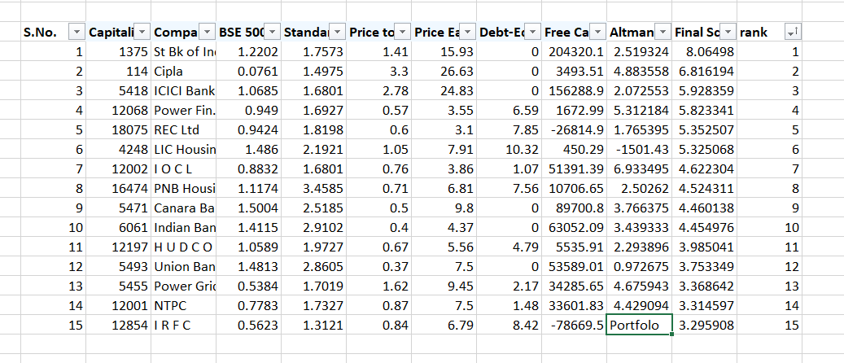

Slide 9
Factors in Altman Z score
A=Working Capital÷Total Assets
B=Retained Earnings÷Total Assets
C=Earnings Before Interest & Tax÷Total Assets
D=Market Value of Equity÷Total Liabilities
E=Sales÷Total Assets
​

Slide 10
Altman Z Score
​
Z-score= (1.2×A) + (1.4×B) + (3.3×C) + (0.6×D) + (1.0×E)

Slide 11
Working Capital/Total Assets (WC/TA) A
Working Capital/Total Assets (WC/TA)
This ratio is an excellent indicator of business trouble. A company with negative working capital is likely to have difficulty paying its short-term obligations because it does not have enough current assets to satisfy such liabilities. A company with considerably positive working capital, on the other hand, seldom has difficulties paying its debts.

Slide 12
RE/TA (Retained Earnings/Total Assets) B
This ratio calculates the amount of earnings or losses reinvested, which represents the level of the company's leverage. Companies with a low RE/TA finance capital expenditures using borrowed funds rather than retained earnings. Companies with a high RE/TA indicate a track record of profitability and the ability to weather a difficult year of losses.

Slide 13
EBIT/TA (Earnings Before Interest and Tax/Total Assets) C
Earnings Before Interest and Tax/Total Assets (EBIT/TA) is a variant of return on assets (ROA), a useful metric for analysing a company's capacity to extract profits from its assets before subtracting factors such as interest and tax.

Slide 14
Market Value of Equity/Total Liabilities (ME/TL) D
This ratio indicates how much a company's market value would decrease if it became bankrupt before liabilities exceeded assets on the financial statements. This ratio gives the model a market value dimension that isn't dependent on pure fundamentals. In other words, a stable market capitalization reflects the market's belief in the company's strong financial situation.

Slide 15
S/TA (Sales/Total Assets) E
This demonstrates to investors how well management controls competition and how effectively the business uses assets to create sales. Failure to increase market share results in a low or decreasing S/TA.

Slide 16
Optimization
Using Efficient Frontier
Maximizing Sharpe Ratio

Slide 17
Efficient Frontier
The efficient frontier depicts portfolios that optimise returns for the risk taken. The investment combinations that comprise the portfolio determine the portfolio's returns. The standard deviation of a security is associated with risk. In an ideal world, an investor would fill a portfolio with securities that provide extraordinary returns while having a total standard deviation that is lower than the standard deviations of the individual securities.

Slide 18
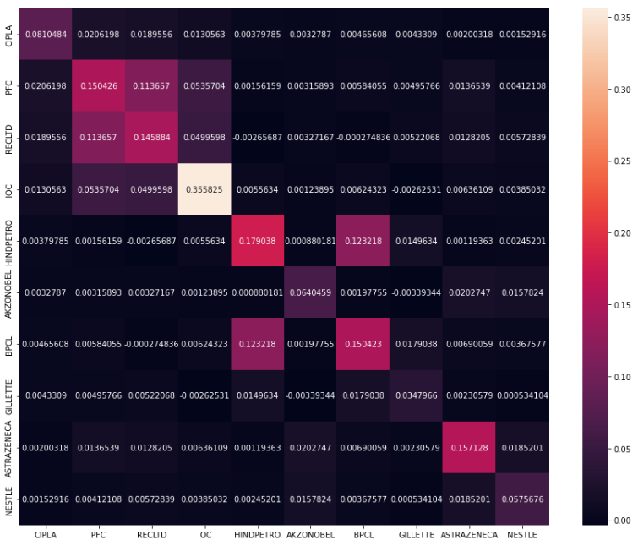
Covariance Matrix

Slide 19
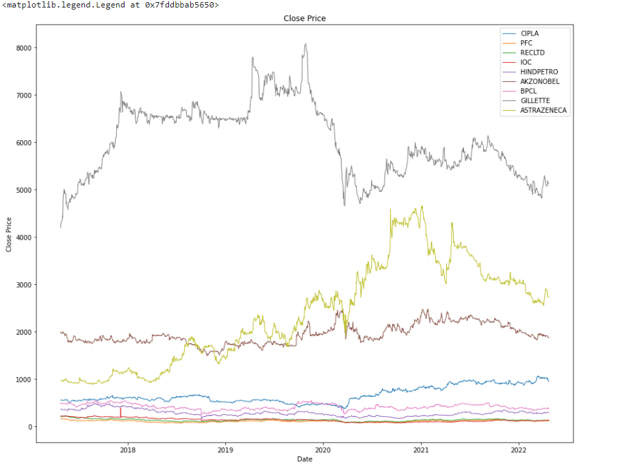
Visualising the stocks

Slide 20
Weights and Expected Return
OrderedDict([('CIPLA', 0.18522), ('PFC', 0.0), ('RECLTD', 0.0), ('IOC', 0.0), ('HINDPETRO', 0.0), ('AKZONOBEL', 0.0), ('COCHINSHIP', 0.0), ('BPCL', 0.0), ('GILLETTE', 0.06289), ('ASTRAZENECA', 0.16271), ('NESTLE', 0.58918)])
Expected annual return: 20.3%
Annual volatility: 17.7%
Sharpe Ratio: 1.03
(0.20256956562418288, 0.17650351617978455, 1.0343678674266157)

Slide 21
Investor Profile
Conservative Investor Portfolio
A conservative portfolio of mutual funds is best if you have a low-risk tolerance. You'll also need a time horizon that extends past three years. Conservative investors are not willing to accept periods of extreme market volatility and seek returns that match or slightly outpace inflation.
Age = 55+
Low risk tolerant
fixed-income investments
Time horizon from immediate to longer than 3 years.

